Slide 1


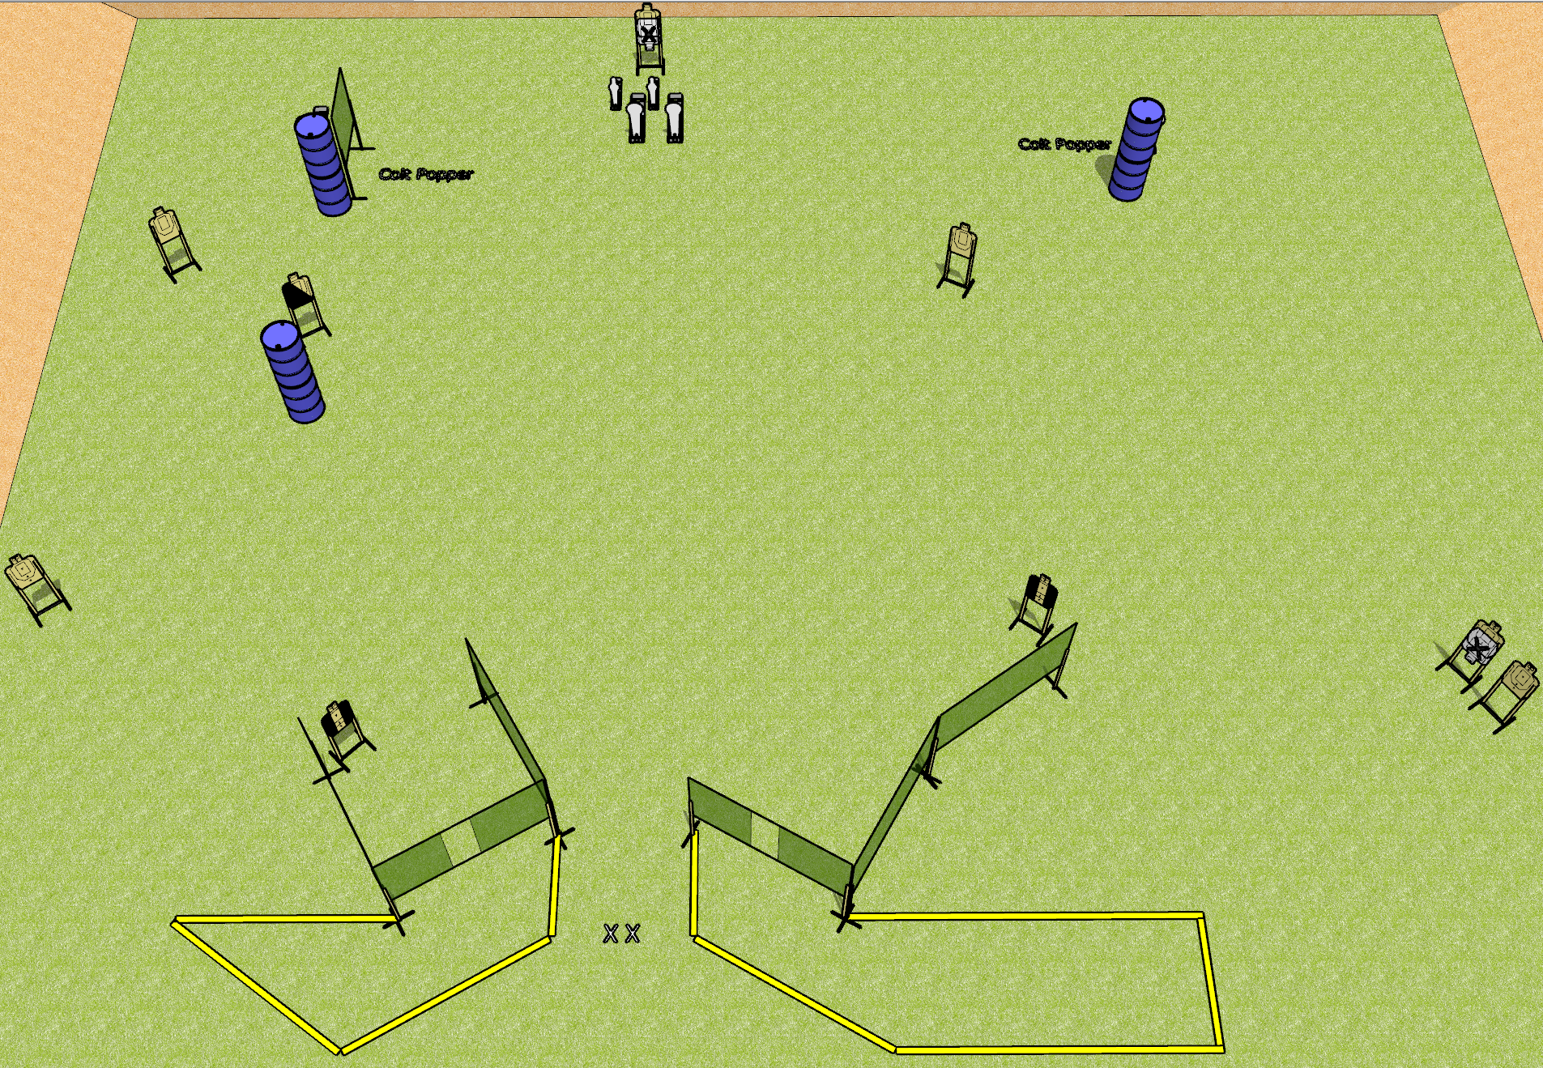
 | Dothan Gun Club – USPSA Match Revenge Course Designer : Drew and Patrick and Rodney Bay: 7
Round Count 24 rounds 9 USPSA 4 colt 2 mini
Equipment List 10 wall feet 2 tuxedos, 1 left diag 8 targets (6 + 2 NS)

Slide 2
Revenge
Written Stage Briefing
Scoring: Comstock Rounds: 24
Targets: 9 USPSA, 6 steel
Handgun start position: feet on X’s, wrists below belt. Handgun is loaded and holstered.
PCC start position: feet on X’s, stock on belt. Loaded carbine is held with both hands, safety on.
Stage Procedure: On the audible start signal, engage targets as they become available from within the shooting area.

